Slide 1
Information on Presentation
Prepare your team practice presentation using ppt.
Presentation time: Week 13 lab time. Each team has 9 minutes to present + 3 min Q&A.
Upload your code (ipynb) and presentation slide (ppt) via ntulearn>tutgroup>assignments >teampractice at least a day before your Week 13 Presentation Day. Name your file Teamxxx.ppt and Teamxxx.ipynb where xxx is your team no.
Only ONE member of each team needs to upload the ipynb and ppt files to avoid duplicates.
Use the following template for your ppt presentation.
Use multiple slides for each section, if necessary.
Try to use print screen or other means to copy figures/results from ipynb into ppt for smooth presentation.
Use markdown cells or # to comment your ipynb.

Slide 2
Design Group: F31 Team 4
Team member:
NAGAR AISHIK (U1822699H)
NEO HUI TENG (U1921248K)
NG ZHENG JIE NICHOLAS (U1822775A)
PATTANAPONG KHAOPAIBUL WU JING HAN
SINGH ARNAV
Food Categories: 3, 5, 7, 8, 9

Slide 3
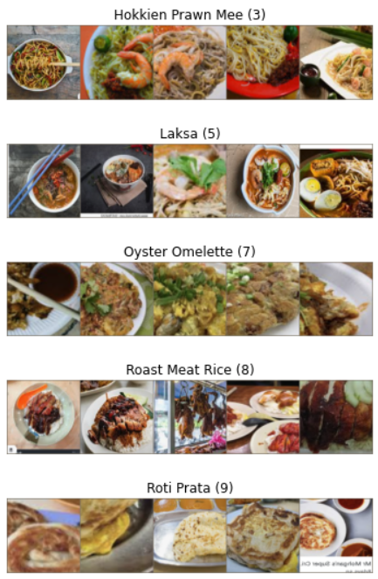
Objective
To predict the classes for the following 5 food categories
Hokkien Prawn Mee (3)
Laksa (5)
Oyster Omelette (7)
Roast Meat Rice (8)
Roti Prata (9)

Slide 4
Exploratory Data Analysis/Visualization
You may want to BRIEFLY present your exploratory data analysis and observations.
Dataset Sizes:
Train: 500 (100 for each class)
Val: 150 (30 for each class)
Test: 999 (200 for each class)

Slide 5
What is Your Model / Methodology / Solution? (1)
Which model do you use? Why?
How does the model solve the problem?
You can choose to study more than 1 model.

Slide 6
What is Your Model / Methodology / Solution? (2)
Which model do you use? Why?
How does the model solve the problem?
You can choose to study more than 1 model.

Slide 7
What are the Outcomes / Results? (1)
Basic Requirements:
What is the accuracy of the model?
Use graphs / tables to present your results.
Any other results / outcomes / analysis.

Slide 8
RESNET Model Family
Model | RESNET18 | RESNET34 | RESNET50 | RESNET101 | RESNET152
Train Accuracy | 83.2 | 78.4 | 83.2
Val Accuracy | 90. | 82.7 | 87.3
Test Accuracy | 84.58 | 81.1 | 89.3
Training Time | 14m 5s | 17m 57s | 23m 3s
Storage | 106 MB | 178.06 MB | 376.84 MB
Trainable Parameters | 2,565 | 2,565 | 10,245
Recall
Precision
F1- Score
Best/Worst Performing class
Additional (?)

Slide 9
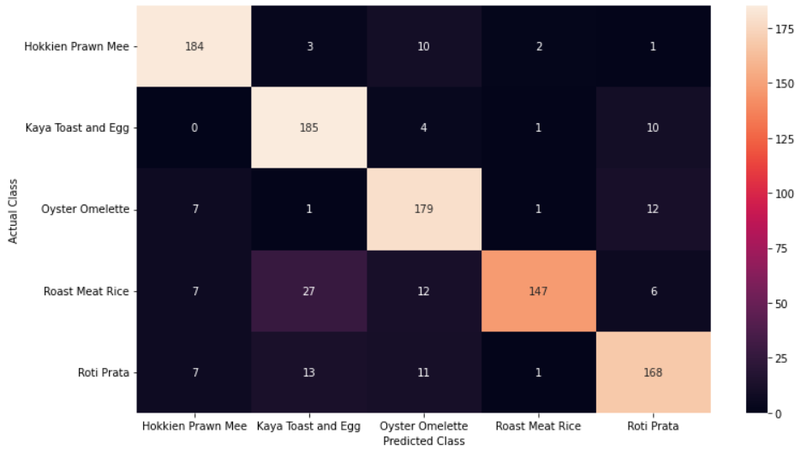

Slide 10
EFFNET Model Family (Aishik)
Model | Effnet B0 | Effnet B1 | EffNet B1 | EffNet B2 | Effnet B3 | EffNet B4
Best Train Accuracy | 0.80 | 0.8160 | 0.6600 | 0.8160 | 0.7900 | 0.7740
Best Val Accuracy | 0.88 | 0.820000 | 0.753333 | 0.860000 | 0.826667 | 0.813333
Test Accuracy | 0.8338 | 0.8208 | 0.6897 | 0.7828 | 0.8068 | 0.7778
Training Time | 3m 40s | 5m 51s | 5m 11s | 5m 27s | 7m 6s | 10m 13s
Learning Rate | 0.01 | 0.01 | 0.001 | 0.01 | 0.01 | 0.01
Total Size | 189.53MB | 270.88 MB | 270.88 MB | 287.40 MB | 382.74 MB | 517.46 MB
Trainable Parameters | 6,405 | 6,405 | 6,405 | 7,045 | 7,685 | 8,965
Total Parameters | 4,013,953 | 6,519,589 | 6,519,589 | 7,708,039 | 10,703,917 | 17,557,581
Macro Precision | 0.837 | 0.811 | 0.702 | 0.787 | 0.809 | 0.787
Macro Recall | 0.834 | 0.825 | 0.69 | 0.783 | 0.807 | 0.778
Macro F1- Score | 0.835 | 0.821 | 0.691 | 0.784 | 0.807 | 0.78
Notes:
Macro Precision, recall and F1 Score:
https://towardsdatascience.com/multi-class-metrics-made-simple-part-ii-the-f1-score-ebe8b2c2ca1

Slide 11
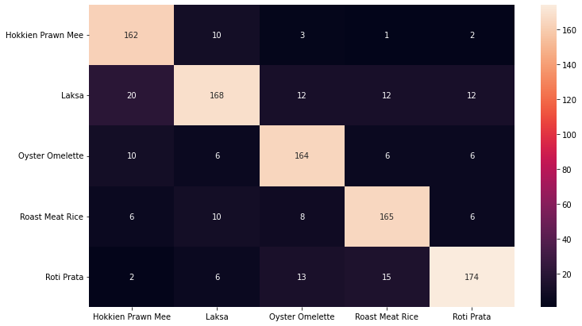
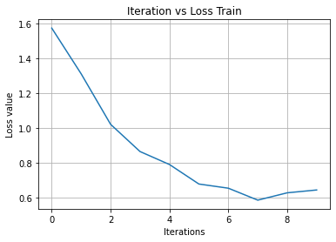
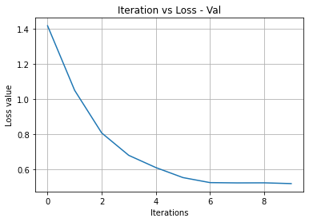
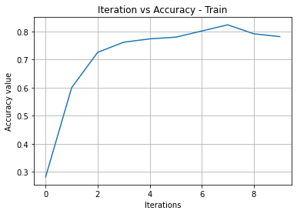
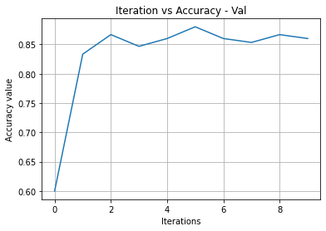
Best Performing EffNet Model - Analysis (Aishik)
 | Precision | Recall | F1
Hokkien Prawn | 0.834 | 0.78 | 0.806
Laksa | 0.655 | 0.74 | 0.695
Oyster Omlette | 0.792 | 0.76 | 0.776
Roast Meat Rice | 0.902 | 0.739 | 0.812
Roti Prata | 0.753 | 0.87 | 0.807

Slide 12
More models
Model | ResNeXt | VGG16 | Mobilenet V2 | Mobilenet V3 (Aishik)
Train Accuracy |  | 84.2 |  | 0.6860
Val Accuracy |  | 84.0 |  | 0.686667
Test Accuracy |  | 83.4 |  | 0.6697
Training Time |  | 16m 14s |  | 1m 34s
Storage |  | 731.59 MB |  | 42.05 MB
Trainable Parameters |  | 20,485 |  | 5,125
Total Parameters |  |  |  | 1,522,981
Macro Precision |  |  |  | 0.726
Macro Recall |  |  |  | 0.67
Macro F1- Score |  |  |  | 0.697

Slide 13
What are the Outcomes / Results? (2)
Advanced Requirements (optional):
Include any other results / outcomes / analysis.

Slide 14
Advanced Requirements - Model Speed and Storage (Aishik)
Algorithmic Improvements
Asynchronous Data Loading and Augmentation
torch.utils.data.DataLoader
num_workers > 0 for asynchronous data loading and overlap between the training and data loading.
pin_memory=True for faster async memory copy to GPU using pinned memory
torch.no_grad() already implemented doe inference and validation
Disable bias for convolutions directly followed by a batch norm - Already implemented in torchvision models
optimizer.zero_grad(set_to_none=True) for reducing memory operations
Fuse pointwise operations -> Experimented but faced decorator error
Enable channels_last memory format -> Data Format change tradeoff too high compared to speed improvement
Disable debugging APIs -> Minor Improvement in speed

Slide 15
Advanced Requirements - Model Speed and Storage (Aishik)
CPU Specific Experimentations
Utilizing Non-Uniform Memory Access (NUMA) Controls
Inference runs best when confining both the execution and memory usage to a single NUMA node.
My Machine had a single NUMA node to begin with, and confining to a single node doubled the training and inference time
Due to the presence of a single NUMA node, concurrent processing by data sharding could not be benchmarked
Utilize OpenMP
OMP variables can define the maximum number of threads to use for OpenMP parallel regions if no other value is specified in the application.
The default value is the number of logical processors visible to the operating system on which the program is executed.
In our case, it was set to the number of physical cores on the machine. The machine could not handle the computation task as such (Maybe since other applications were also running). In any case, the improvement in training/inference speed was negligible since default values were already probably optimized

Slide 16
Advanced Requirements - Model Speed and Storage (Aishik)
GPU Specific Improvements
CUDA based GPU server was used. This allowed experimentation with CuDNN based optimizations.
Enabling cuDNN auto-tuner using ```torch.backends.cudnn.benchmark = True``` runs tests to benchmark optimal kernels for convolution operations.
The first epoch is slow since benchmark tests are run, after which there is considerable improvement in training and inference speed.
Avoiding unnecessary CPU-GPU synchronization based operations and memory migration calls
Creating tensors directly on the target device
Mixed precision and AMP
Potentially up to 3x speed improvements with minor compromise on accuracy
In our case, the model performed slower than normal - This is since our server had a very old GPU (1080 ti), and did not have Tensor Cores enabled
AMP enabled training was still tested, but was much slower
Parallelized training using ```torch.nn.parallel.DistributedDataParallel ``` could not be tested since shared server was being used with other GPU’s under use.

Slide 17
Advanced Requirements - Model Speed and Storage (Aishik)
Deployment Based Improvements
ONNX Runtime is a performance-focused engine for ONNX models, which inferences efficiently across multiple platforms and hardware
UNDER PROGRESS - Server was busy

Slide 18
Advanced Requirements - Model Speed and Storage (Aishik)
Optimization Techniques Benchmark - VGG16 on GPU based training/eval
 | Training Time | Best Validation Accuracy | Evaluation Time | Test Accuracy
Basic Implementation | 34s | 0.860000 | 3.8709s | 0.8519
Async Data Loading | 26s | 0.867 | 2.8116s | 0.8519
Data with Channel Last | 59s | 0.86 | 5.7637s | 0.8559
Disabling Debugging API | 38s | 0.88 | 3.5918 | 0.8458
Efficient setting of 0 gradients | 38s | 0.873 | 3.9804 | 0.8358
With CuDNN Benchmarking [Gets faster with more epochs] | 28s | 0.87 | 5.0374 | 0.8398
Using AMP | 43s | 0.867 | 3.6246 | 0.8388
Using AMP + Gradient Clipping | 43s | 0.867 | 3.7654 | 0.8549
Combined (Positive Contributions only) | 28s | 0.853 | 2.98 | 0.8258

Slide 19
Advanced Requirements - Model Speed and Storage (Aishik)
Deployment Techniques Benchmark - VGG16 Torch vs ONNX
 | Evaluation Time | Test Accuracy
Torch Based Implementation
ONNX Converted Inference

Slide 20
Advanced Requirements - Model Speed and Storage (Aishik)
Model Deployment

Slide 21
New Knowledge Learnt
Do you learn something new?

Slide 22
Individual Contribution + Q & A (1)
You MUST clearly indicate the individual contribution of each member in your team.

Slide 23
Individual Contribution + Q & A (2)
 | Member 1 | Member 2 | Member 3 | Member 4 | Member 5
Task 1 | x
Task 2 | supporting | x |  |  | x
Task 3 |  | x | supporting | x
Task 4 |  |  | x
… |  |  |  |  | x

